Slide 1


Slide 2
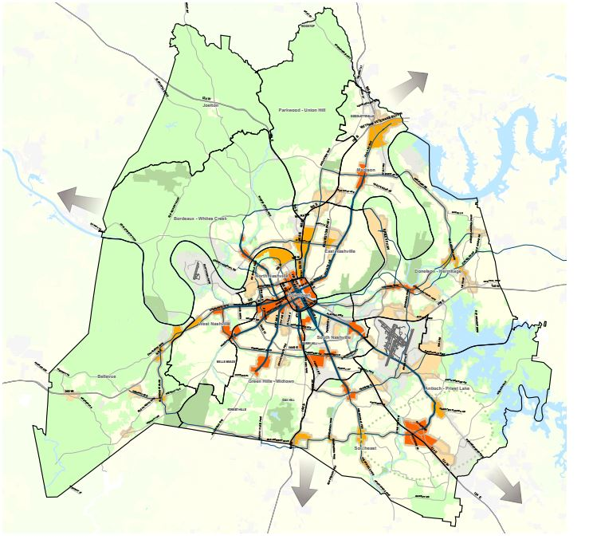
MTA/RTA Strategic Planning Process
Goal: 10,000 interactions in 2015
  Extensive civic engagement
Goal: To develop a great regional transit system
  Update every five years
  All options considered
#nMotion2015
Notes:
Use the hashtag #nmotion2015 to continue the discussion on social media

Slide 3


Why undertake the effort?
Growth: Nashville is growing rapidly – from a small city to a large city
Inadequate Transportation Infrastructure: Nashville Vital Signs Report: “The ability of our residents to move around the region in their cars is quickly deteriorating”
Community-Wide Priority: NashvilleNext: 17,000 Nashvillians rate transit second-highest priority

Slide 4
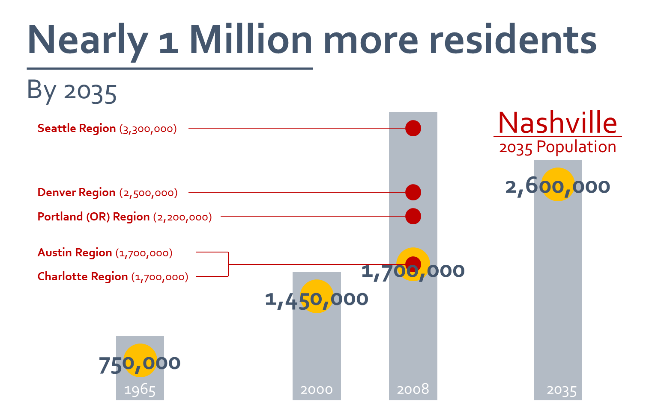
Why Mass Transit?

Slide 5
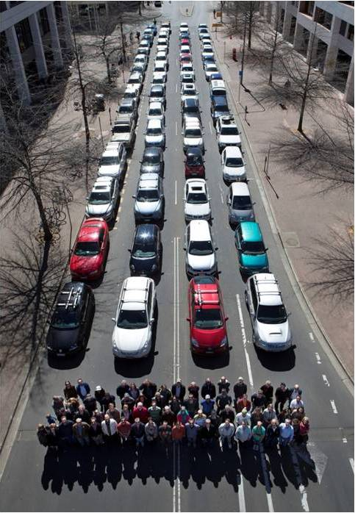
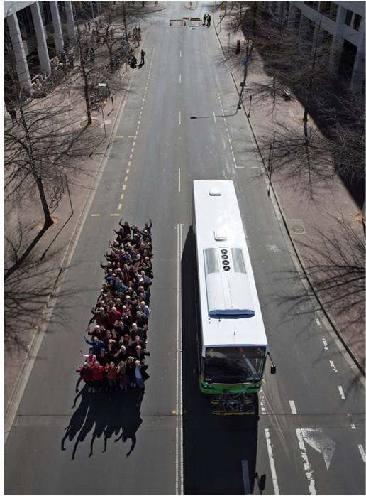
Why Mass Transit?
Moving people efficiently
Notes:
Every person on the bus is one less car on the road
This is approximately 60 people in their cars vs. 60 people on the bus

Slide 6
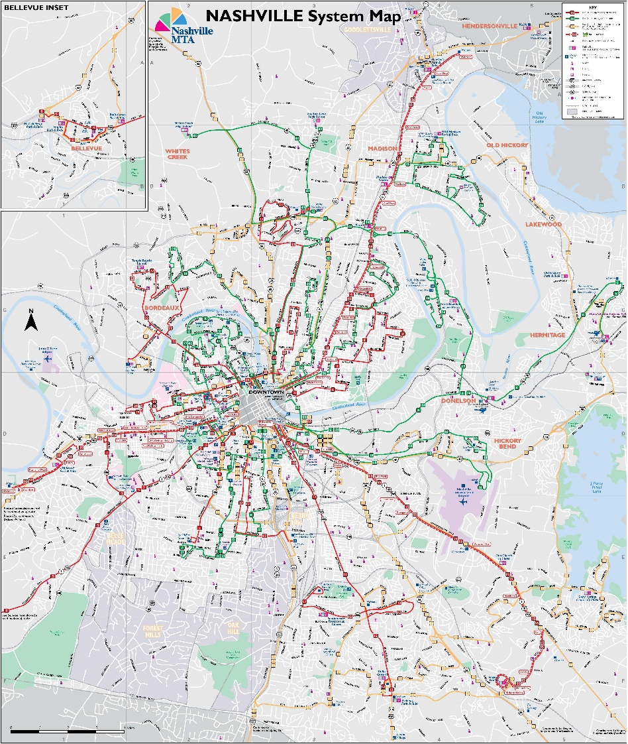
Existing Service
3 BRT Lite routes
14 “Most Frequent” routes that operate every 30 minutes or better on weekdays
14 “Frequent” routes that operate every 31 to 90 minutes
22 “Limited” routes that mostly provide express service
3 Music City Circuit routes that operate in and around downtown
AccessRide
  Available throughout county

Slide 7
Total MTA Ridership
Notes:
This is MTA ridership only. Does not include RTA

Slide 8
MTA Operating Funds
$13.4 M
$16 M
Funds come from a mix of sources:
    MTA Self-Generated - $16 M
    Local (Metro) - $36.4 M
    State - $4.6 M
    Federal - $13.4 M
Fiscal Year 2015
Total Budget: $70.4 million
$36.4 M
$4.6 M

Slide 9
What are the challenges?
Sprawl: Nashville is one of the most sprawling metro areas in the country
Population densities in many areas are not sufficiently high enough for high levels of transit service
Wide arterial roads are difficult for passengers to cross

Slide 10
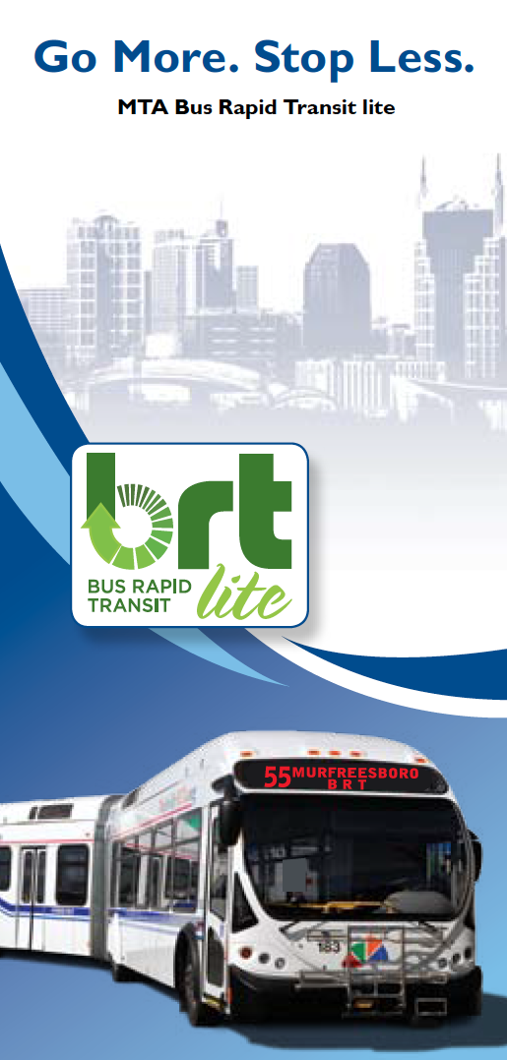
What are Nashville’s transit strengths?
Strong core: network of routes to and from downtown Nashville
Current Service Upgrades: Higher-quality service is in development, and some has already been implemented, such as BRT lite on several arterial routes and the Music City Circuit downtown

Slide 11
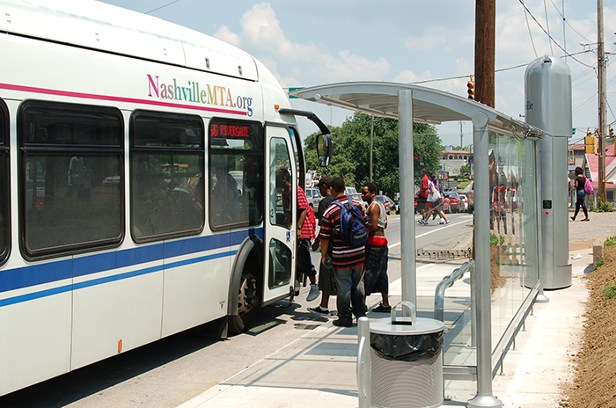
What are Nashville’s transit weaknesses?
Service is not attractive or convenient enough for most
  Infrequent service
  Limited hours
  Slow service
  Most service goes to and from downtown, making travel to other locations inconvenient

Slide 12
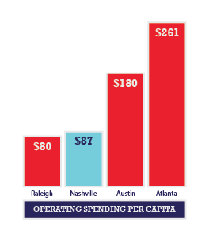
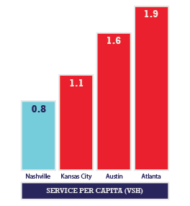
How does Nashville compare?
Compared to peers like Austin, Charlotte or Denver, Nashville:
  Spends less on transit.
  Provides less service.
  Carries fewer riders.

Slide 13
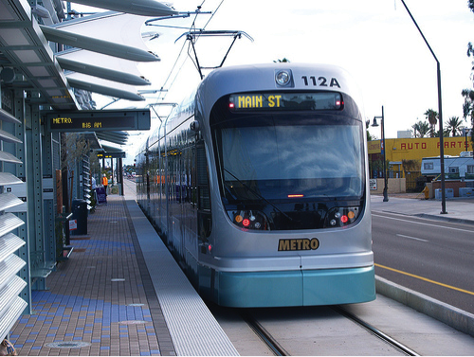
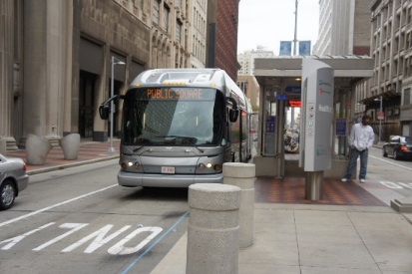

What are some potential improvements?
High-capacity, rapid transit options (rail, BRT, etc.)
More transit options on major corridors
Service to more places
Faster service
Transit priority (dedicated lanes, signal prioritization, etc.)
Increased park and ride
Safer access and pedestrian improvements
Simpler service
More comfortable facilities with better amenities
Real-time information
Customer service
Coordinated routes and scheduling
Outlying transit centers
Other ideas …?

Slide 14
nMotion Timeline

Slide 15
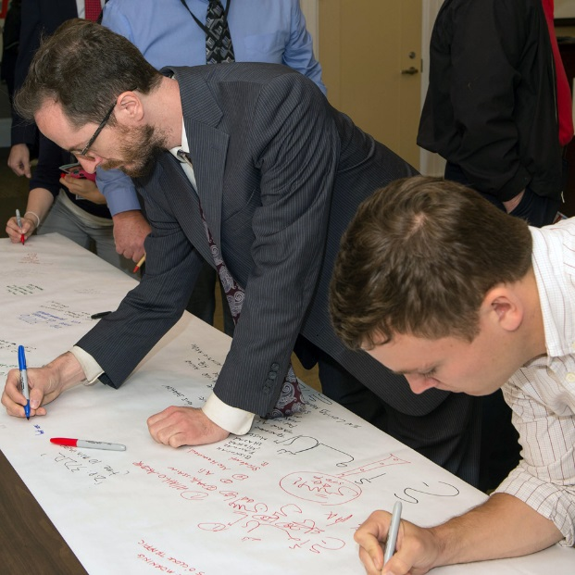
Share your experiences
How often do you use public transportation? Why?
How long is your commute?
Notes:
We would have a big paper rolled out like we did at the kickoff meeting but we will have it marked with distinct sections for each potential answer to match the survey.
How often do you use public transportation?
More than once a day
Once a day
Several times a week
Once a week
Less frequently than once a week
Never
How long is your commute? 0-10 min.
11-20 min.
21-30 min.
30 min. or more
Each participant will be asked to place a post it in the appropriate section to answer question and everyone can also write an explanation of why or whatever else they want to tell us on the post it note. We would also ask that every participant write their zip code on the post it note

Slide 16
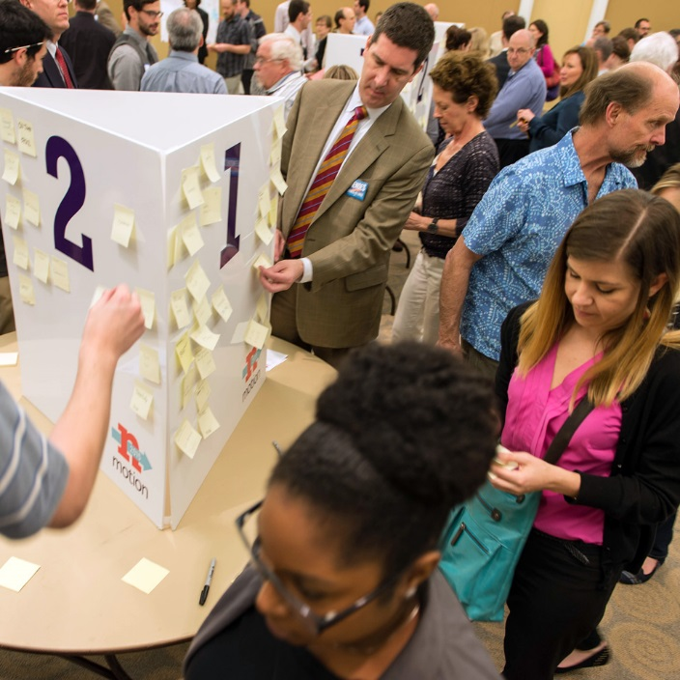
Share your values
Convenient
Dependable
Frequent
Safe
Notes:
To date, more than 2,000 Middle Tennesseans have taken the MTA survey identifying the values that should guide the strategic planning process for Nashville’s transit system. Four values top the list:
Convenient
Dependable
Frequent
Safe
We’d like to understand more fully what you mean by these values.

Slide 17
Share your values
Convenient
Notes:
Convenient: What should we do to make service convenient?
Provide more frequent service
Operate for longer hours on weekdays
Provide more service on weekends
Provide service to more locations
Get me to my destination faster
Provide better information, including real-time schedule information
Provide service that doesn't require passing through Downtown
Other _______________
Write the answers on a white board or notepad

Slide 18
Share your values
Dependable
Notes:
Dependable: What should be done to make service dependable?
A transit system that always arrives on or close to schedule
that delivers me to my destination at the time scheduled
that comes at the same time every day.
Be on-time
Come at the same time every day
Be there when I need it
Other _______________
Write the answers on a white board or notepad

Slide 19
Share your values
Frequent
Notes:
Frequent: How often does service need to operate for you to consider it frequent?
Major routes _______ mins
Other routes _______ mins
Write the answers on a white board or notepad

Slide 20
Share your values
Safe
Notes:
Safe: What should be done to make service safer?
Improve security on-board buses
Improve security at major transit facilities
Locate stops in well-lit areas
Make it easier to walk to and from stops with more sidewalks, crosswalks and signals
Other _______________
Write the answers on a white board or notepad

Slide 21
Thank You

Slide 22
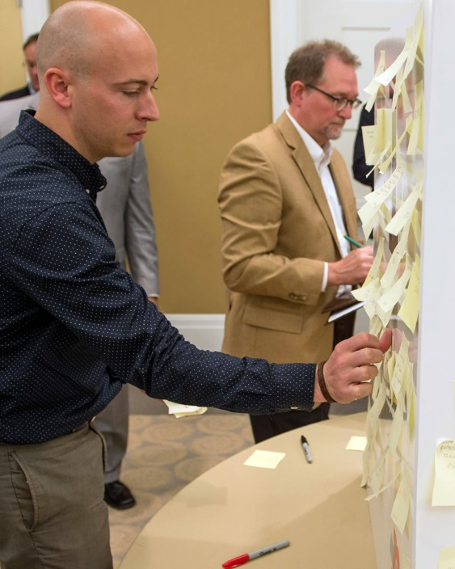
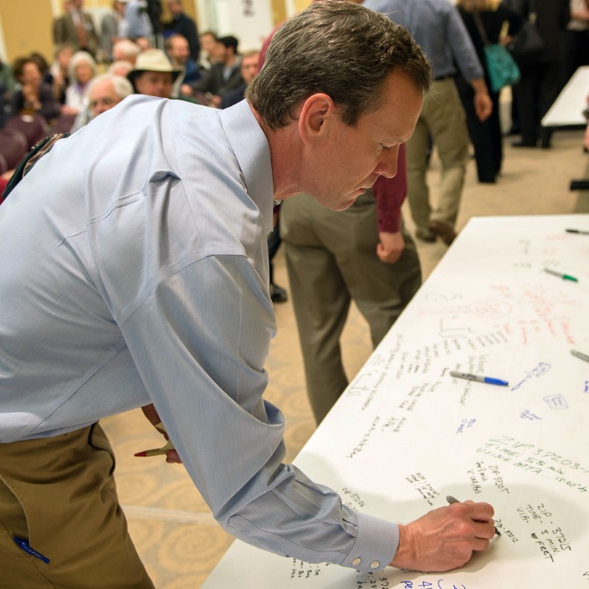
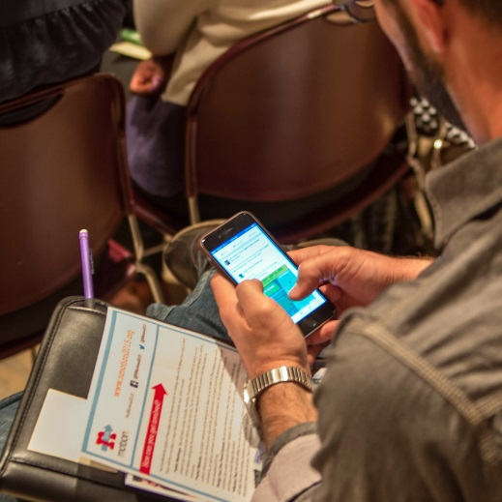
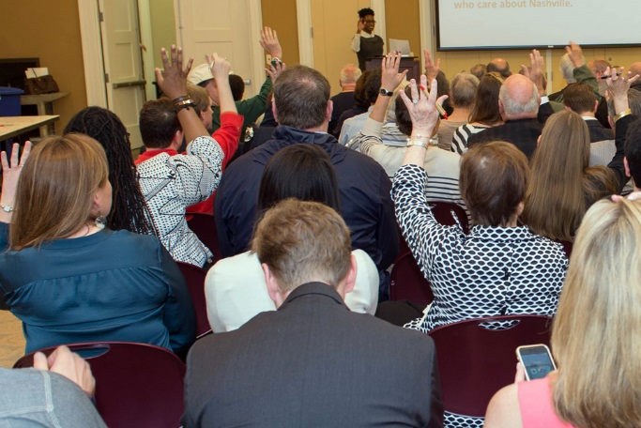
Questions?
Insert photo from first public meeting
Notes:
Here we will have asked participants to fill out comment cards if they had a question when they came in and throughout. The facilitator will say “we probably won’t have time for everyone’s questions but let me try to get through a few. If we don’t get to yours, you will receive a response from the MTA within two weeks” While the participants are doing the exercise the facilitator would have reviewed all the comment cards and selected the ones that make the most sense to answer for the benefit of the whole group.

